Slide 1
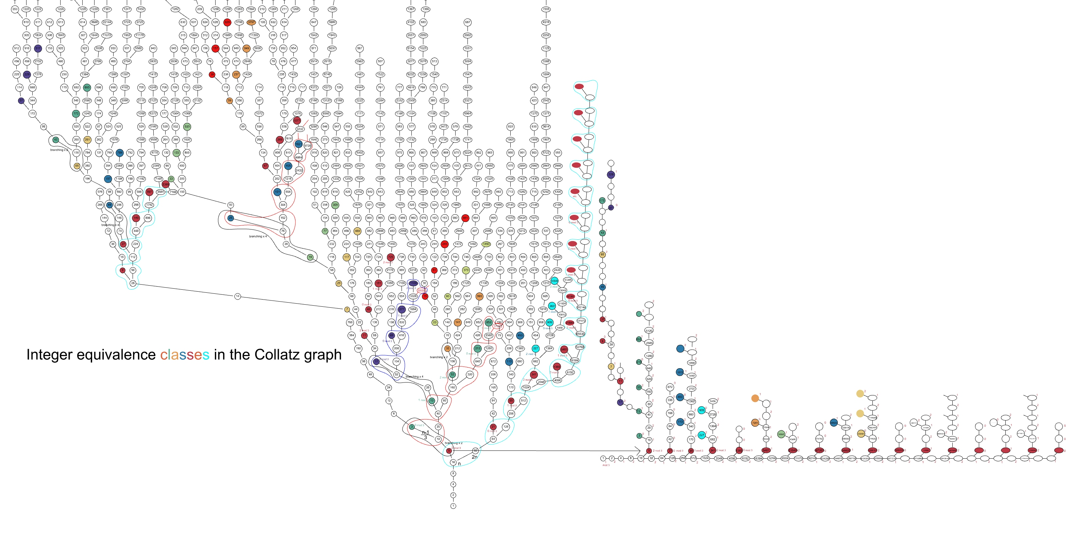

Collatz Decoded
This video is an introduction to an analysis of the Collatz function
The source Excel sheet is available at
https://21stcenturyparadox.com/2025/12/06/collatz-decoded-7-12-25/
Notes:
This video is an introduction to an analysis of the Collatz function

Slide 2
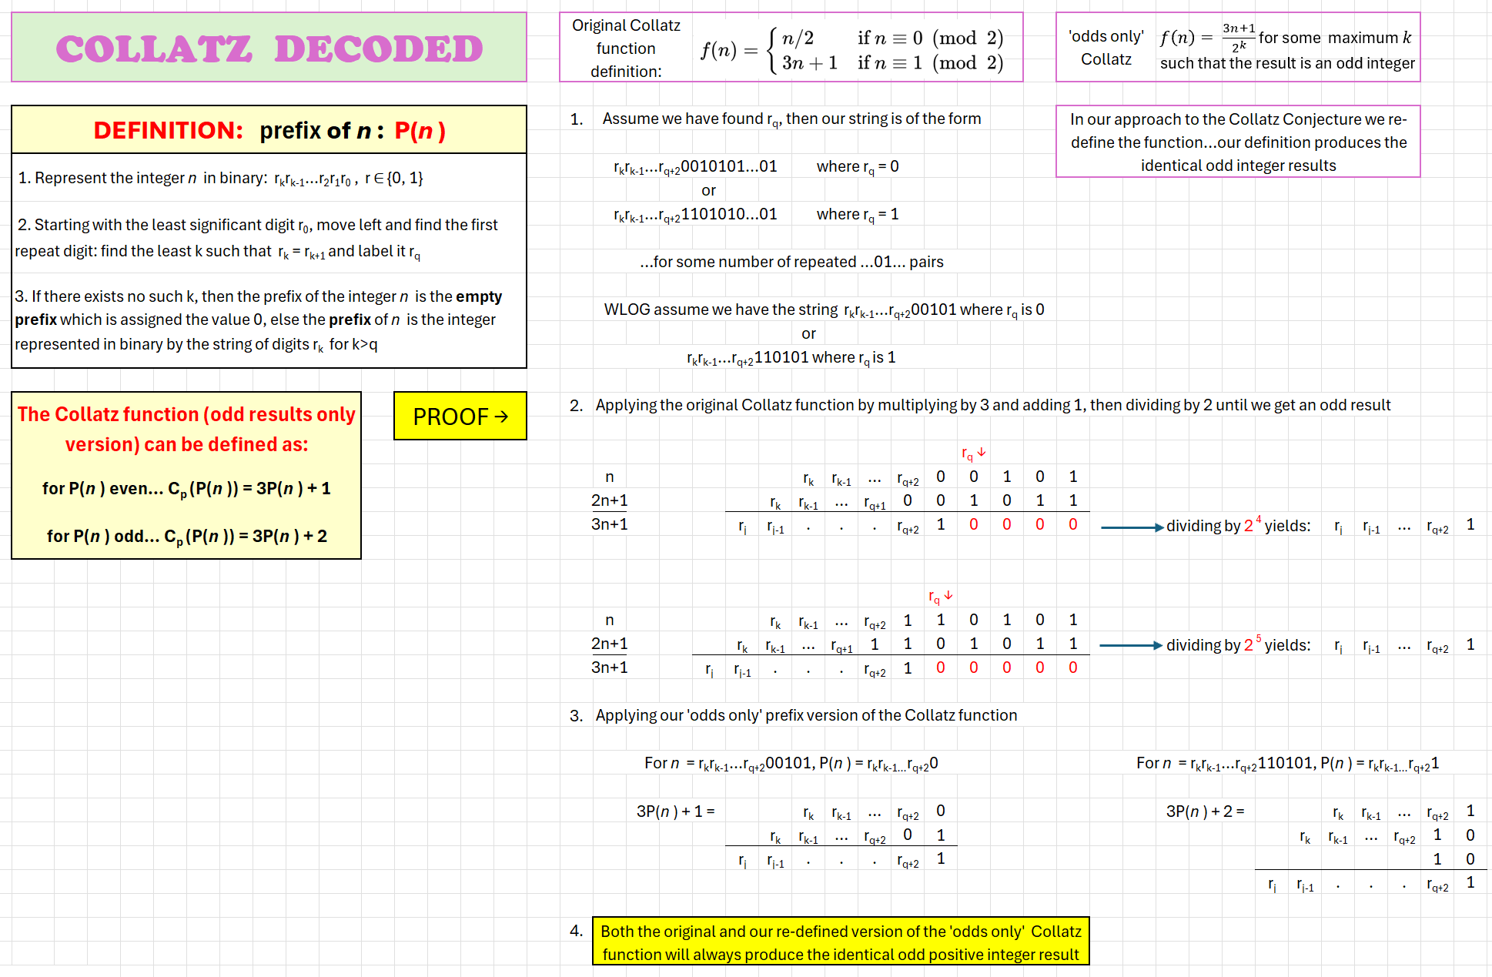
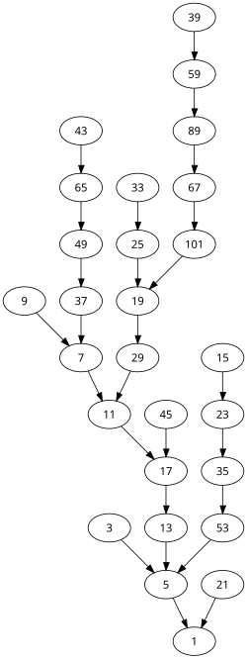
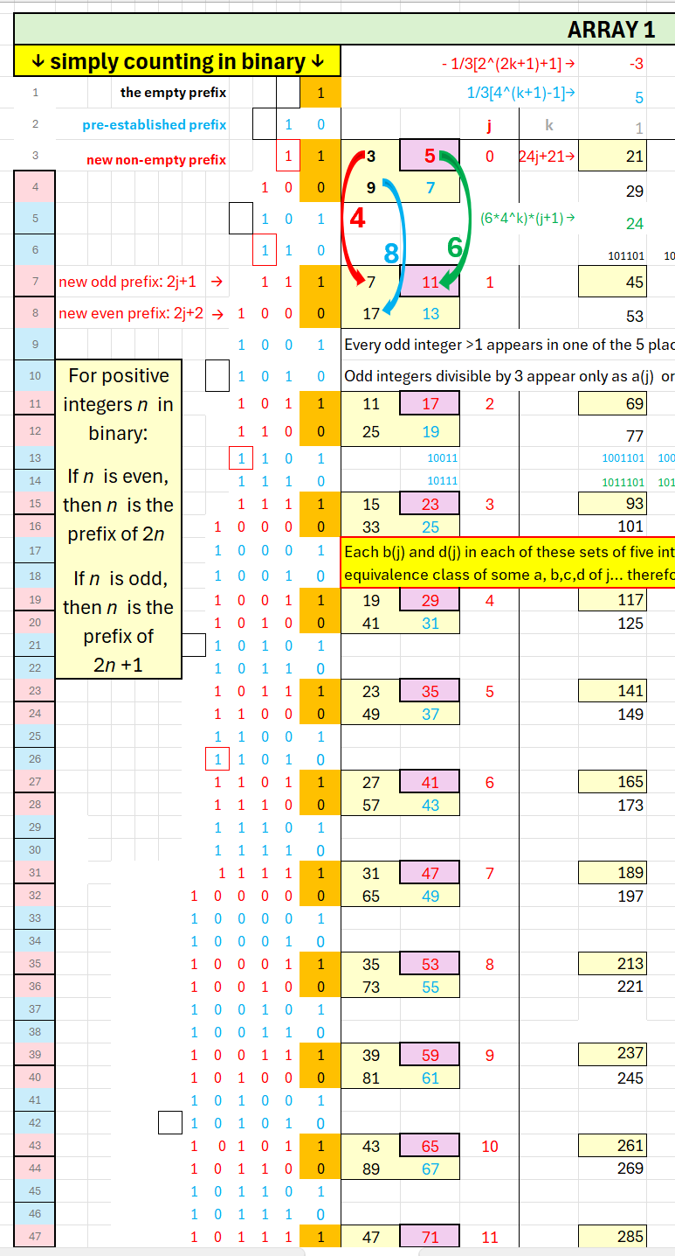
1. Explain the fundamental significance of the prefix definition for positive integers represented in binary…explain prefix, extensions, and equivalence classes.
2. Prove that our prefix method is a valid re-interpretation of the Collatz ‘odds-only’ function and that it yields odd integer results identical to those resulting from the original definition of the Collatz function
Our view of the Collatz function results is founded on a partition of the positive integers into equivalence classes defined by the prefix of their binary representation. We can re-define the Collatz function and produce the identical odd integer results using our definition of prefix.
Notes:
Our view of the Collatz function results is founded on a partition of the positive integers into equivalence classes defined by the prefix of their binary representation. We can re-define the Collatz function and produce the identical odd integer results using our definition of prefix.

Slide 3
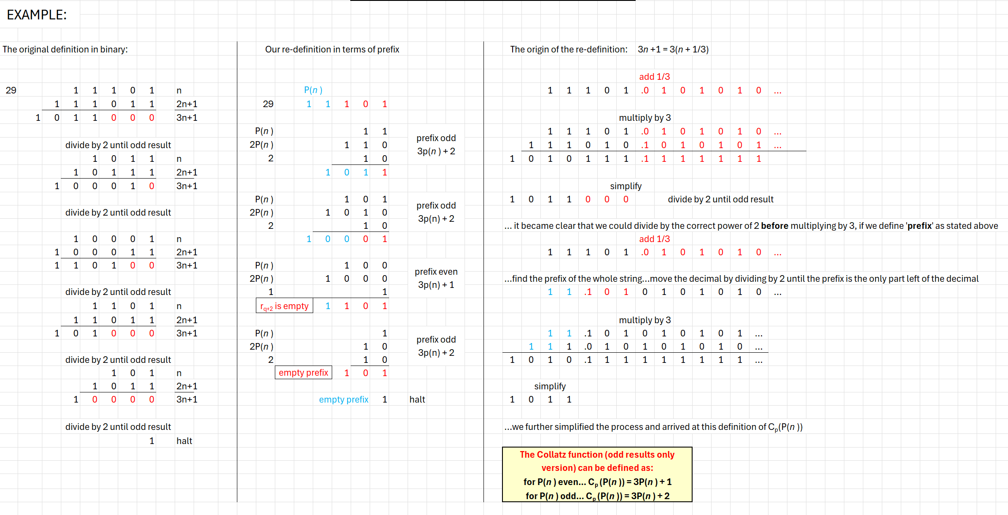
Results from the original Collatz function and our prefix class method.
Notes:
Results from the original Collatz function and our prefix class method.

Slide 4
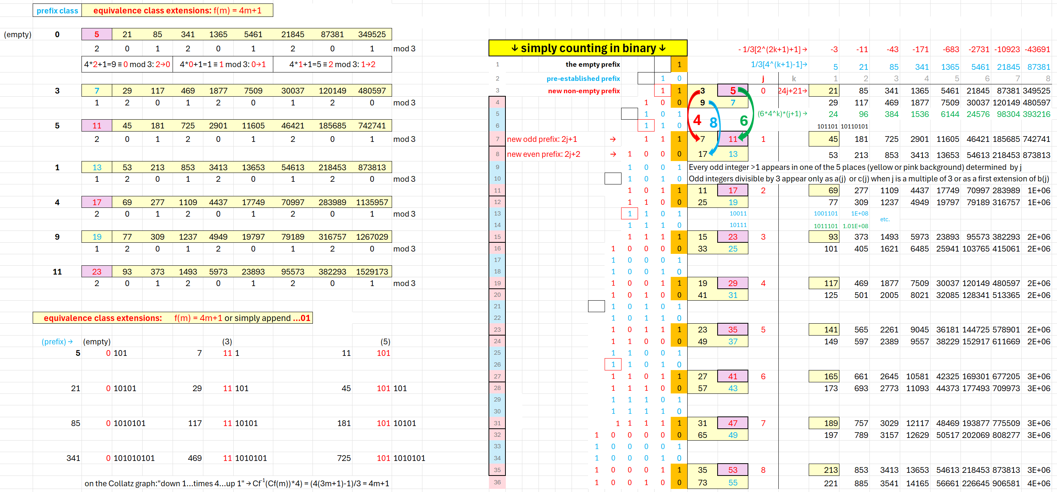
The members of each class of integers have the identical prefix. The original Collatz function applied to any member of a class will produce a single, identical odd number result for every member. With our prefix class view we elevate the original Collatz function from a function on individual odd integers to a function on whole classes of integers. Once this is done the Collatz function becomes deterministic and the conjecture obviously true.
Notes:
The members of each class of integers have the identical prefix. The original Collatz function applied to any member of a class will produce a single, identical odd number result for every member. With our prefix class view we elevate the original Collatz function from a function on individual odd integers to a function on whole classes of integers. Once this is done the Collatz function becomes deterministic and the conjecture obviously true.

Slide 5
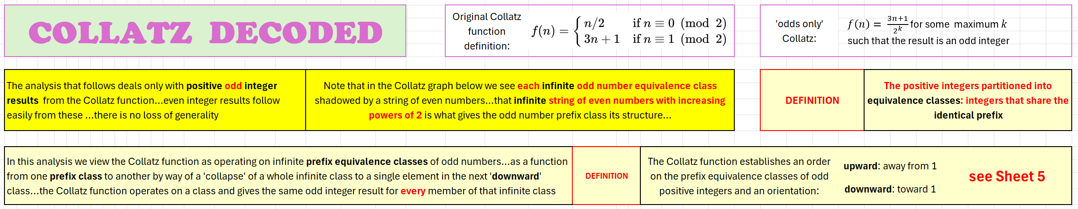
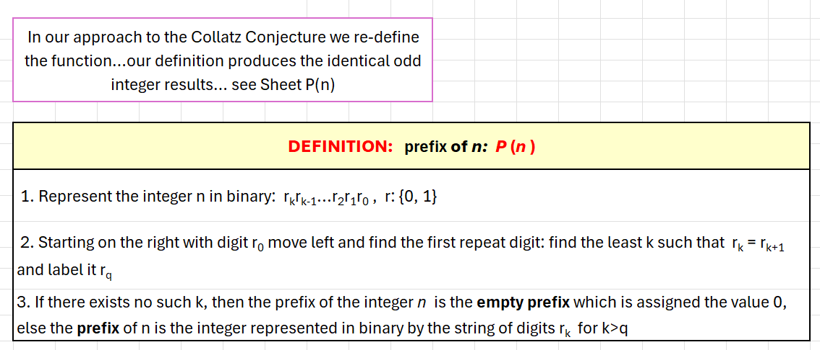
Every odd integer is present and connected in the graph.
Notes:
Every odd integer is present and connected in the graph.

Slide 6
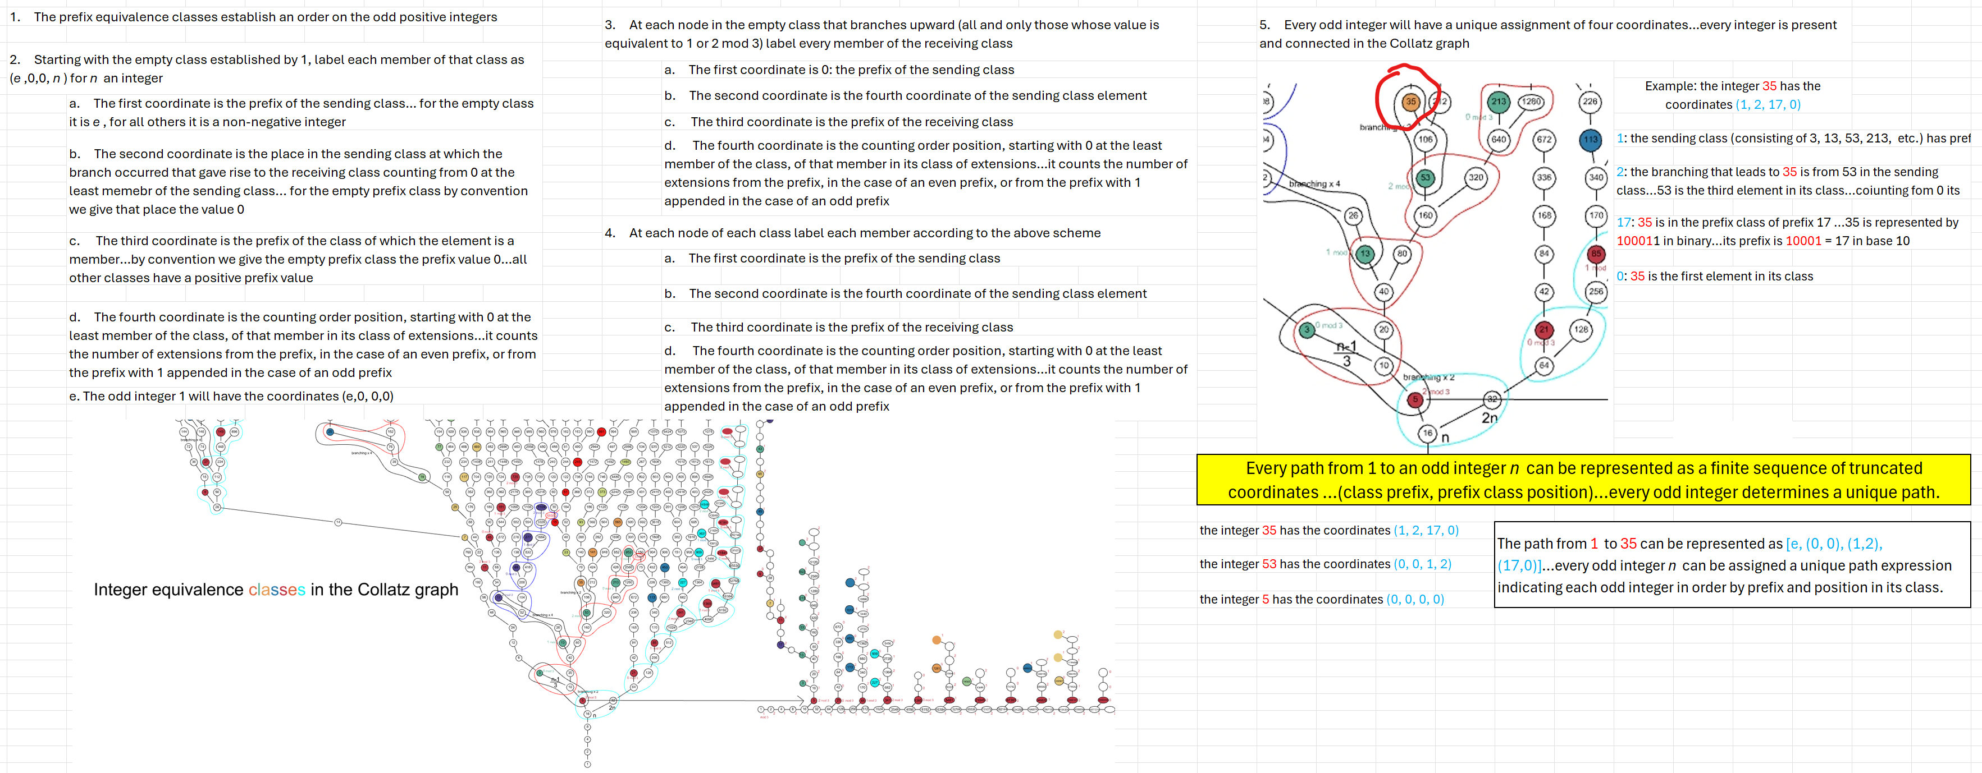
Each odd integer can be assigned a unique set of four coordinates. Every odd integer n can also be assigned a unique path represented in terms of prefix class and class position for each odd integer on the path from 1 to n. Every integer is present and connected to 1 in the Collatz graph.
Notes:
Each and every odd integer can be assigned a unique set of four coordinates. Every odd integer n can also be assigned a unique path represented in terms of prefix class and class position for each odd integer on the path from 1 to n. Every integer is present and connected to 1 in the Collatz graph.

Slide 7
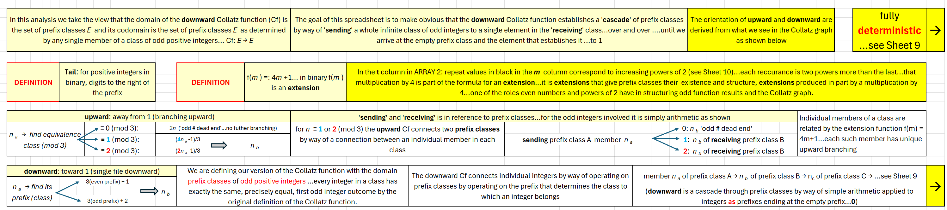
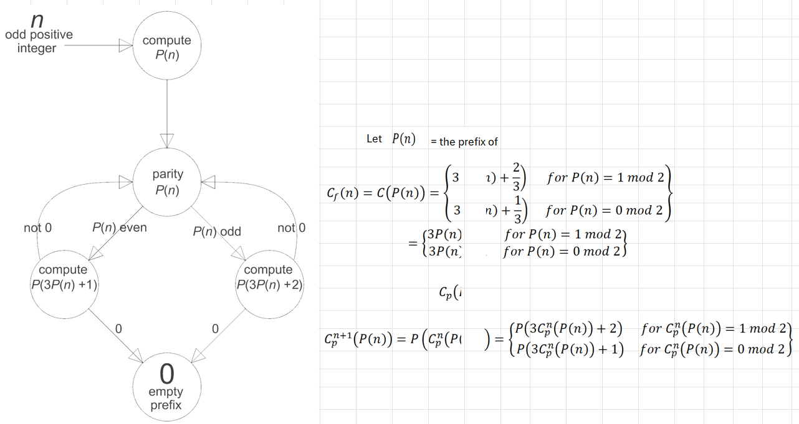
When viewed in terms of equivalence classes the Collatz function becomes fully deterministic.
Notes:
When viewed in terms of equivalence classes the Collatz function becomes fully deterministic.

Slide 8
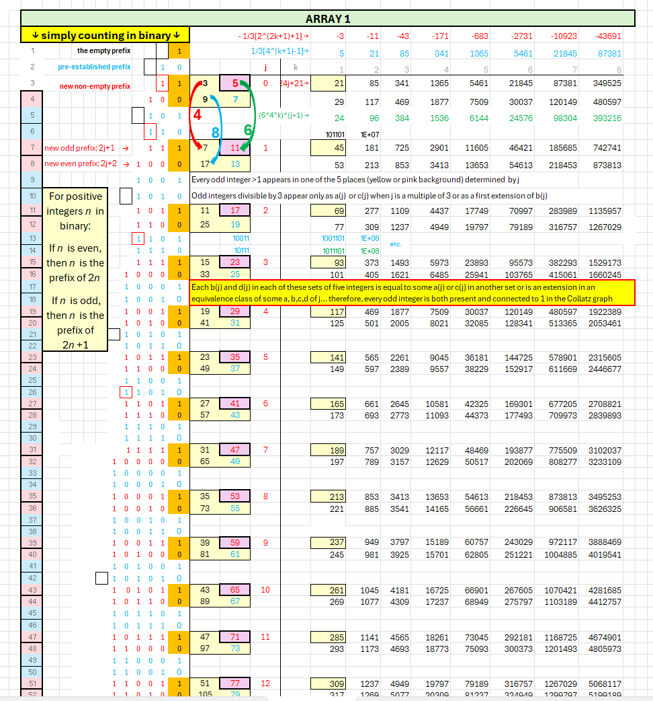
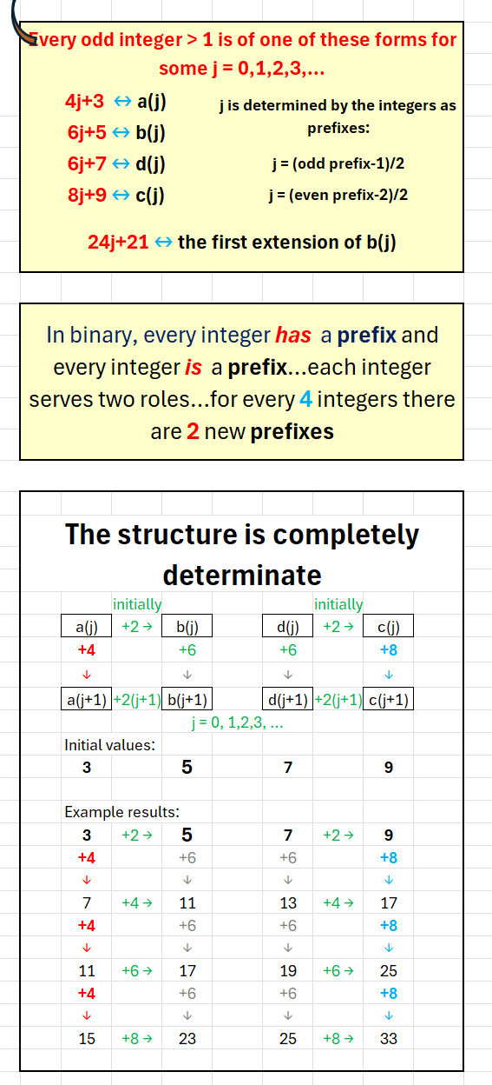
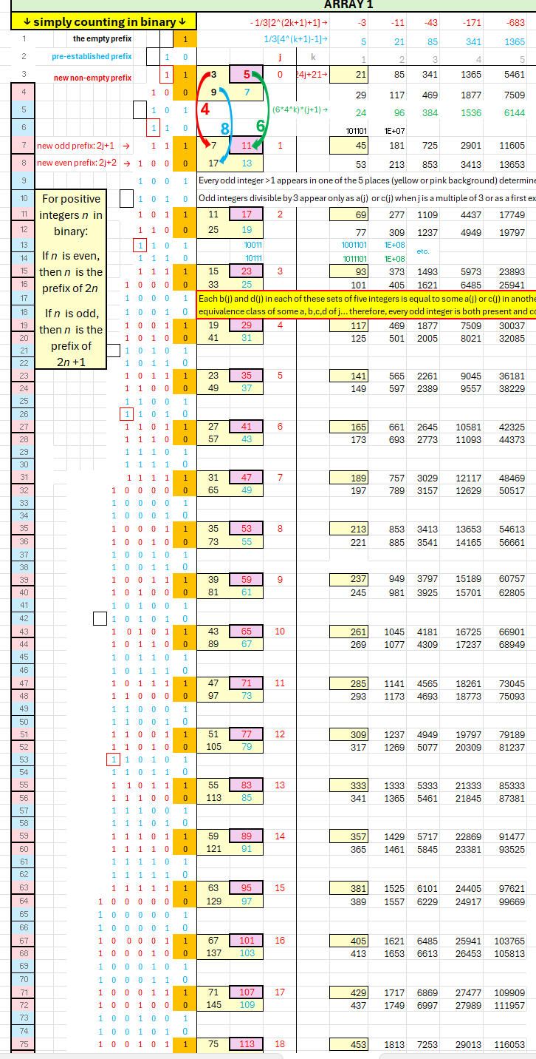
When we put the integers in counting order and apply the Collatz function we begin to see that there is nothing random about the results. The view in terms of equivalence classes makes clear the structure of the odd integer results. With the integers in counting order we can prove that every odd integer is present in the graph and is connected to every other integer. There can be no cycles other that at 1 since each equivalence class will only branch to another class through a unique pair of members of those two classes…there can be no return for any other branching upward. As presented on Sheet 5 each odd integer will have a unique set of coordinates.
Notes:
When we put the integers in counting order and apply the Collatz function we begin to see that there is nothing random about the results. The view in terms of equivalence classes makes clear the structure of the odd integer results. With the integers in counting order we can prove that every odd integer is present in the graph and is connected to every other integer. There can be no cycles other that at 1 since each equivalence class will only branch to another class through a unique pair of members of those classes…there can be no return for any other branching upward. As presented on Sheet 5 (slide 6) each odd integer will have a unique set of coordinates.

Slide 9
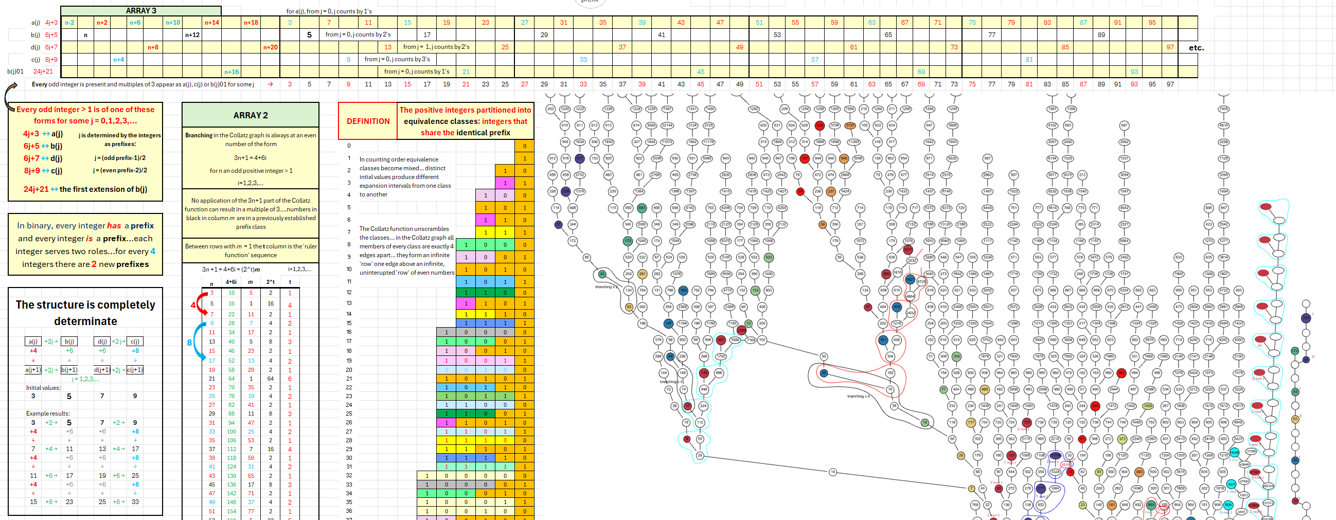
ARRAY 3 provides an inductive proof that every odd integer is present in the graph. ARRAY 2 shows that every odd integer that is a multiple of 3 is connected to exactly one other odd integer, and every odd integer not a multiple of 3 is connected to exactly 2 other odd integers…no multiple of 3 produces a branching upward
Notes:
ARRAY 3 provides an inductive proof that every odd integer is present in the graph. ARRAY 2 shows that every odd integer that is a multiple of 3 is connected to exactly one other odd integer, and every odd integer not a multiple of 3 is connected to exactly 2 other odd integers…no multiple of 3 produces a branching upward

Slide 10
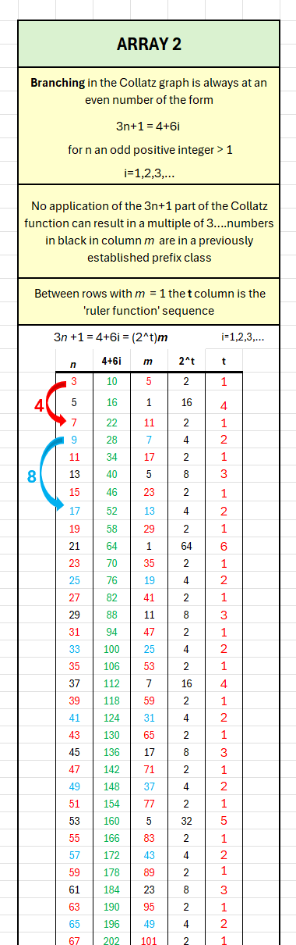
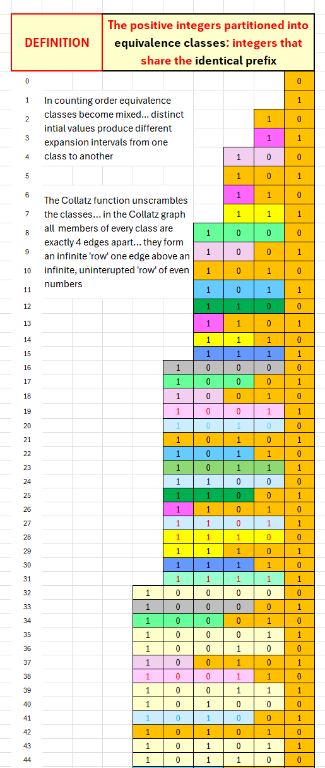
ARRAY 2 gives the information for every branching in the graph
In counting order the number of integers between elements in a class grows exponentially…in counting order the classes become mixed
Notes:
ARRAY 2 gives the information for every branching in the graph… In counting order the number of integers between elements in a class grows exponentially…in counting order the classes become mixed

Slide 11
In the Collatz graph the number of edges between members of a class is fixed…each member is 4 edges apart
Notes:
In the Collatz graph the number of edges between members of a class is fixed…each member is 4 edges apart

Slide 12
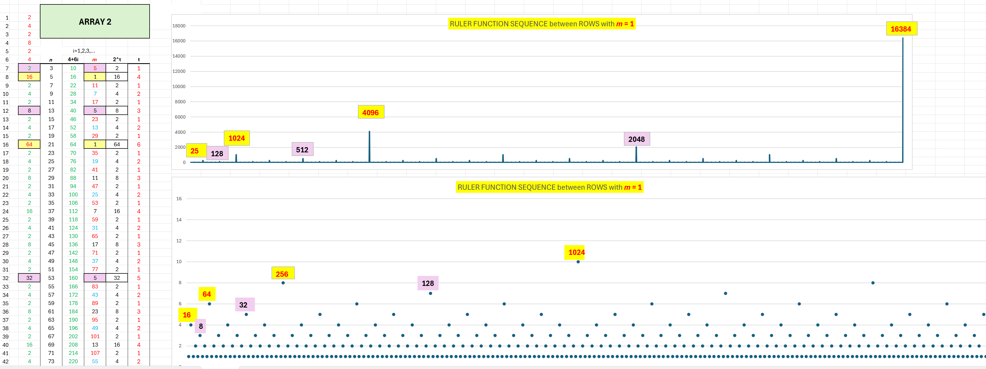
With the odd integers in counting order, ARRAY 2 shows that the number of divisions by 2 required by the original Collatz function is fully determinate.
Notes:
With the odd integers in counting order, ARRAY 2 shows that the number of divisions by 2 required by the original Collatz function is fully determinate.

Slide 13
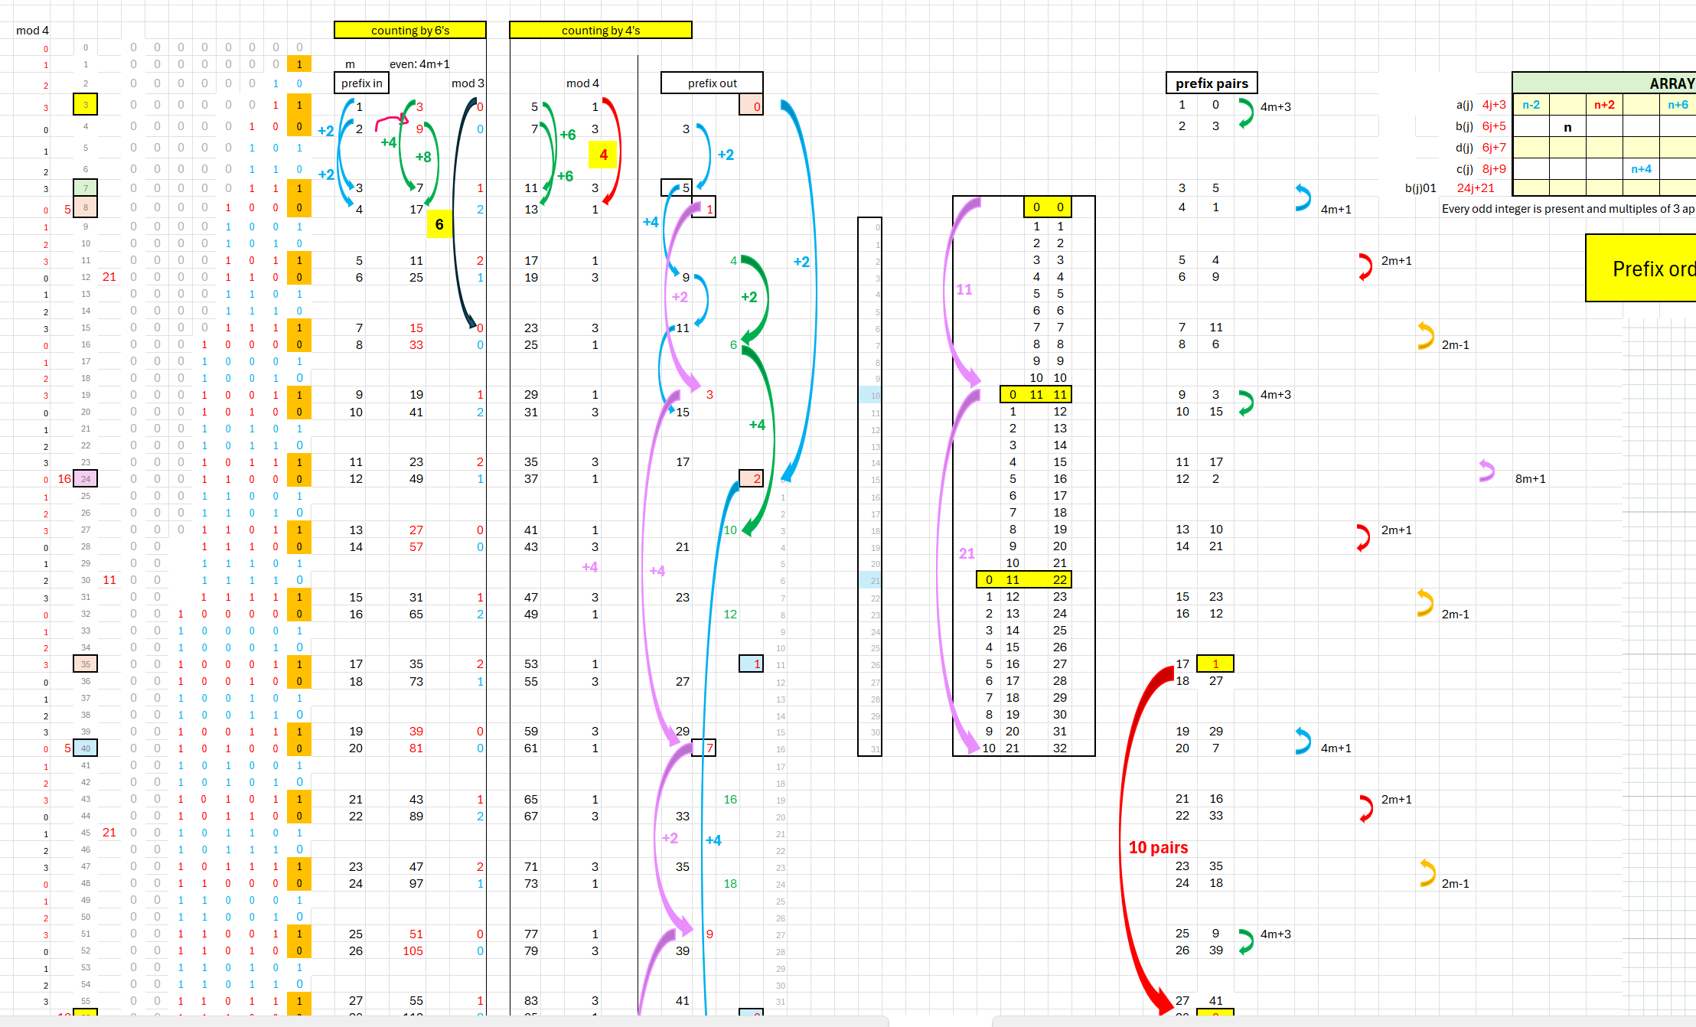
With the integers in counting order, if we pair the prefix of the input integer with the prefix of the corresponding output of the Collatz function we see further structure.
Notes:
With the integers in counting order, if we pair the prefix of the input integer with the prefix of the corresponding output of the Collatz function we see further structure.

Slide 14
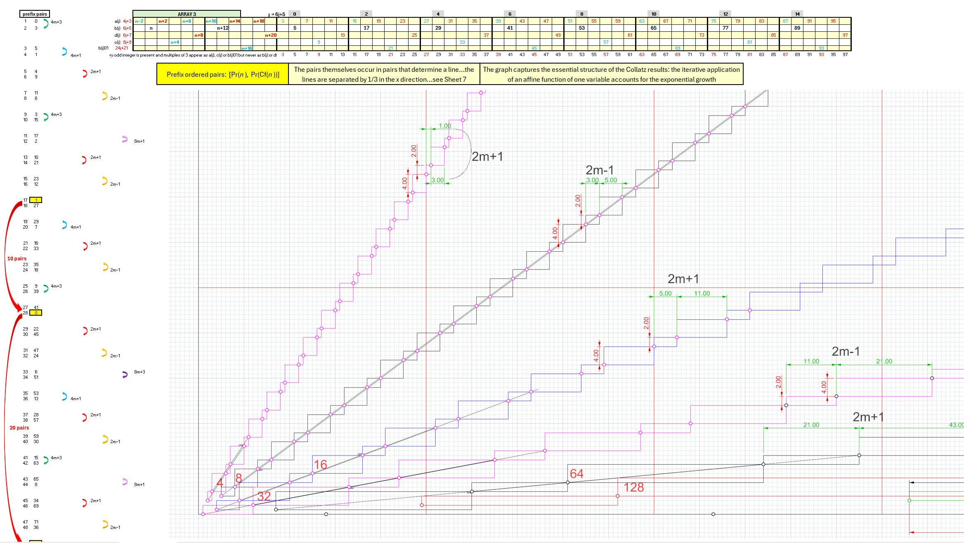
The graph shows the structure of the set of pairs of prefix pairs
Notes:
The graph shows the structure of the set of pairs of prefix pairs

Slide 15
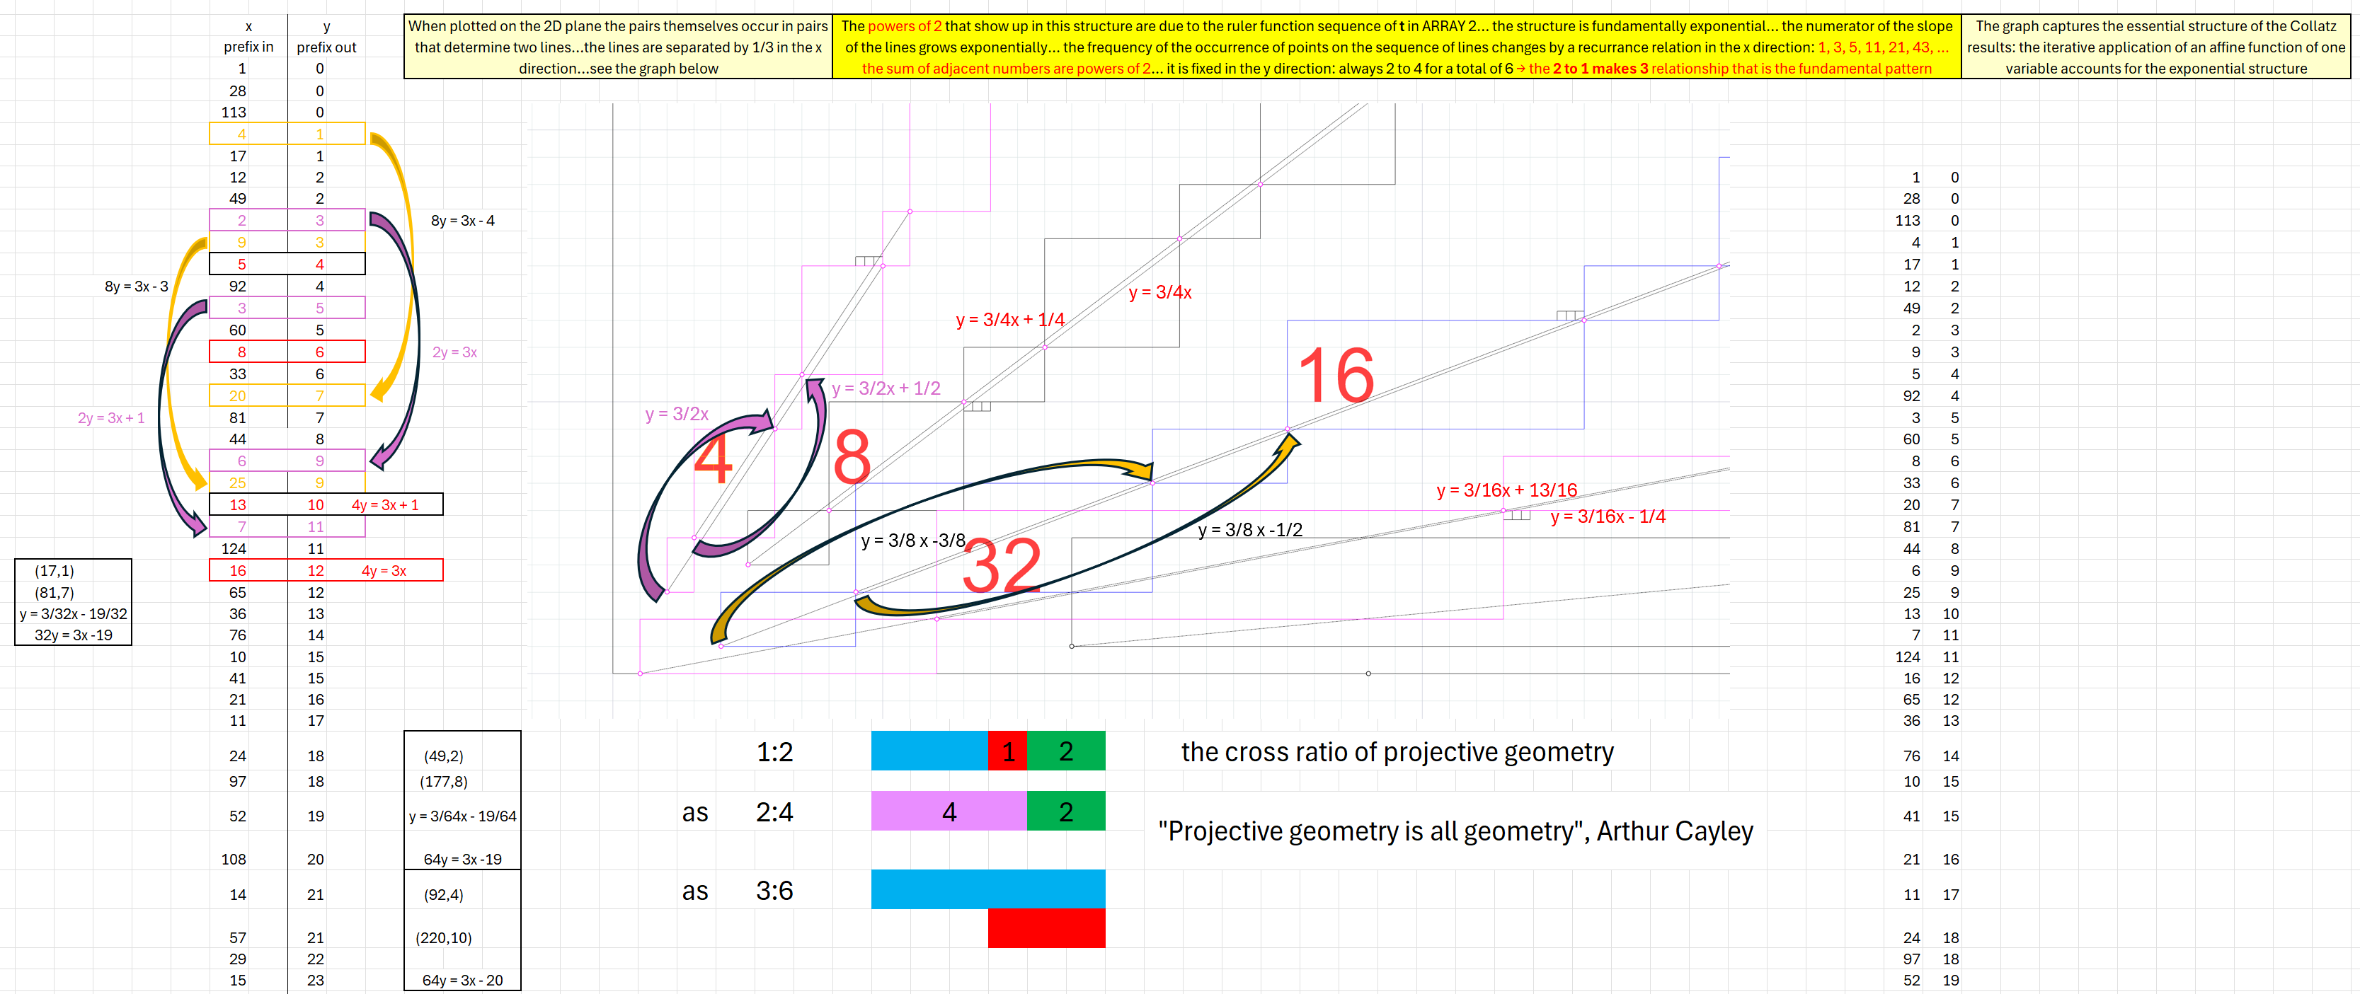
A closer look at the structure
Notes:
A closer look at the structure

Slide 16
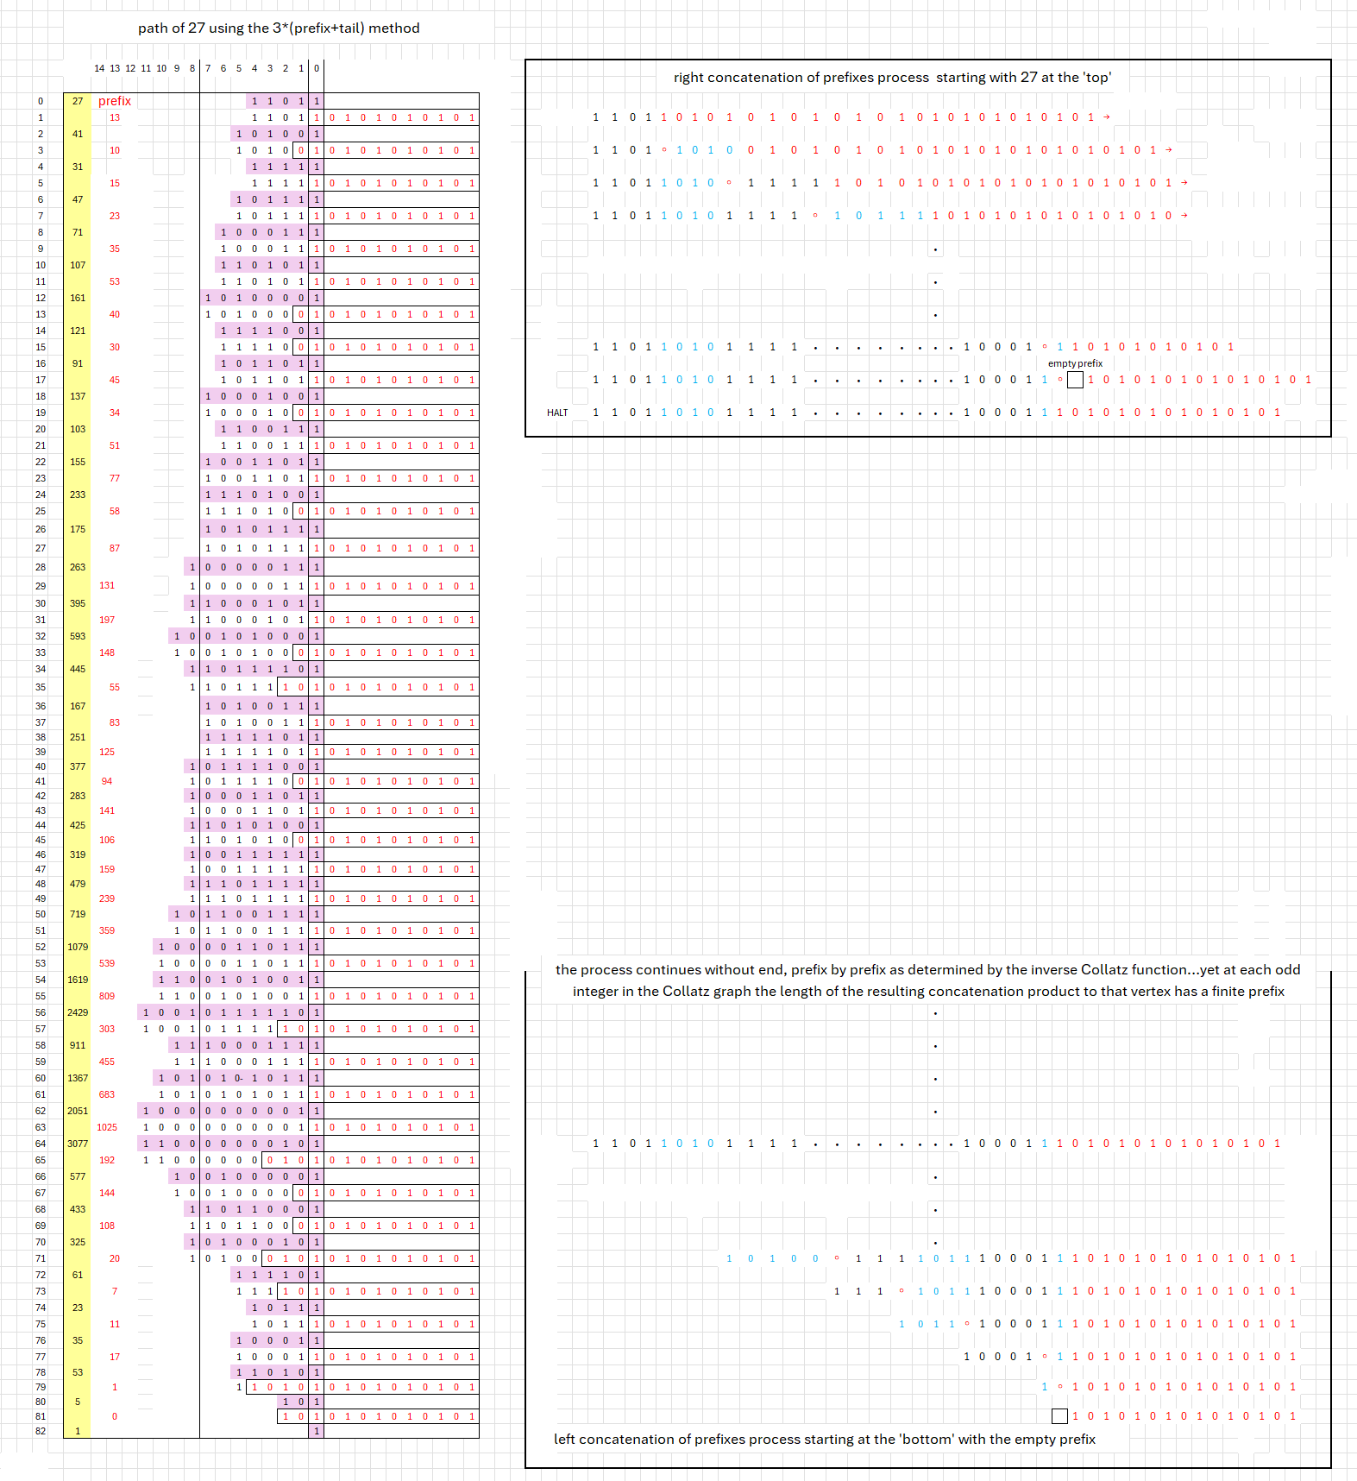
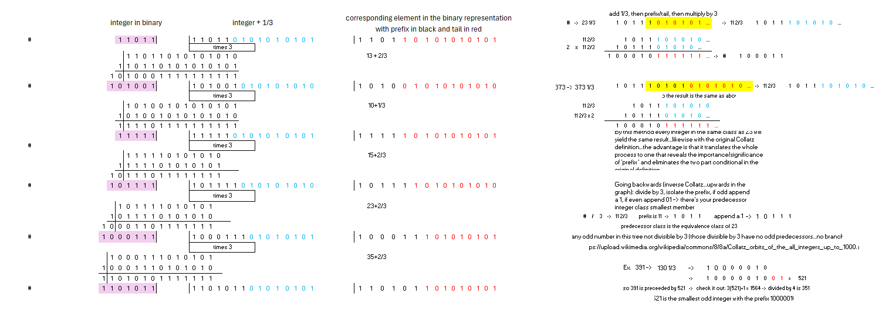
An example of the concatenation of prefixes, ‘upward’ from 5 and ‘downward’ from 27…the concatenation of the prefixes in each path in the Collatz graph upward from 1 to a chosen odd integer produces a unique finite string of digits…that string is itself the prefix of a string with an infinite alternating tail.
Notes:
An example of the concatenation of prefixes, ‘upward’ from 5 and ‘downward’ from 27…the concatenation of the prefixes in each path in the Collatz graph upward from 1 to a chosen odd integer produces a unique finite string of digits…that string is itself the prefix of a string with an infinite alternating tail.

Slide 17
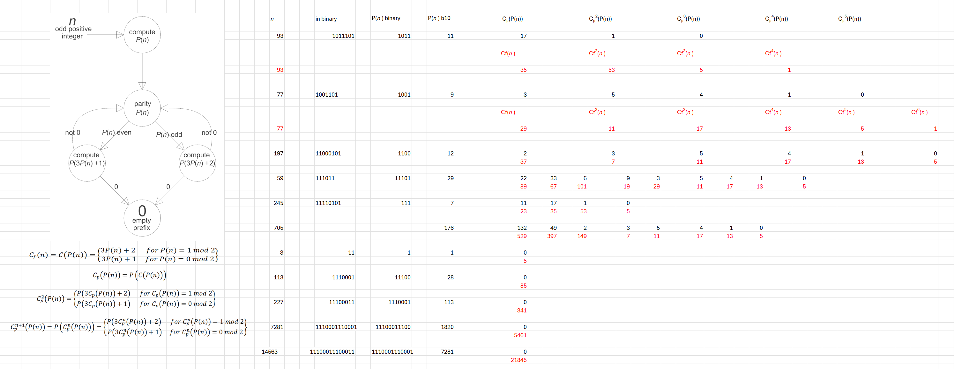
The automata version of the ‘odds-only’ prefix class Collatz function…when viewed as a function on prefix equivalence classes the Collatz function becomes fully deterministic
Notes:
The automata version of the ‘odds-only’ prefix class Collatz function…when viewed as a function on prefix equivalence classes the Collatz function becomes fully deterministic

Slide 18
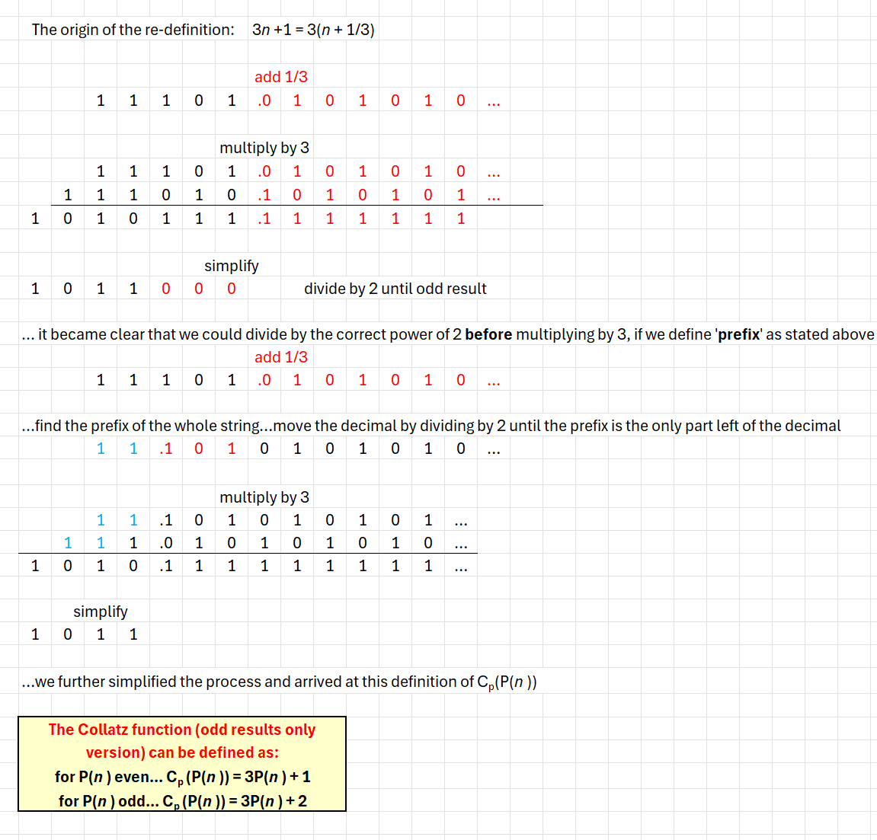
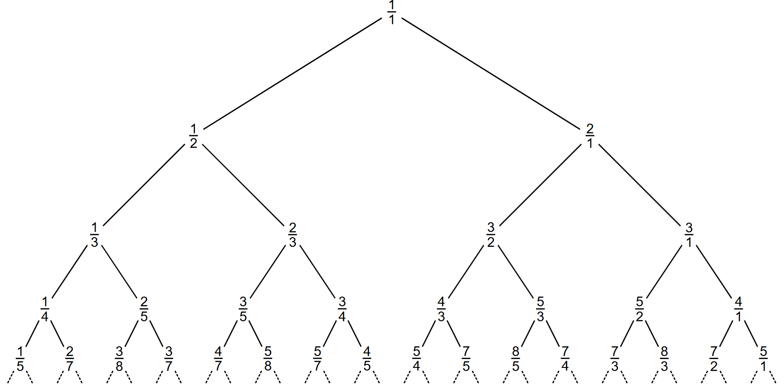
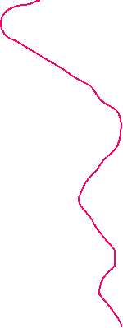
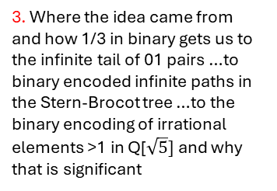
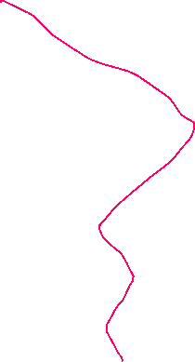
3. Where the idea came from and how 1/3 in binary gets us to the infinite tail of 01 pairs …to binary encoded infinite paths in the Stern-Brocot tree …to the binary encoding of irrational elements >1 in Q[$\sqrt{5}]$ and why that is significant
The path through vertices corresponding to convergents of the continued fraction representation of the Golden Mean
Notes:
The path through vertices corresponding to convergents of the continued fraction representation of the Golden Mean

Slide 19
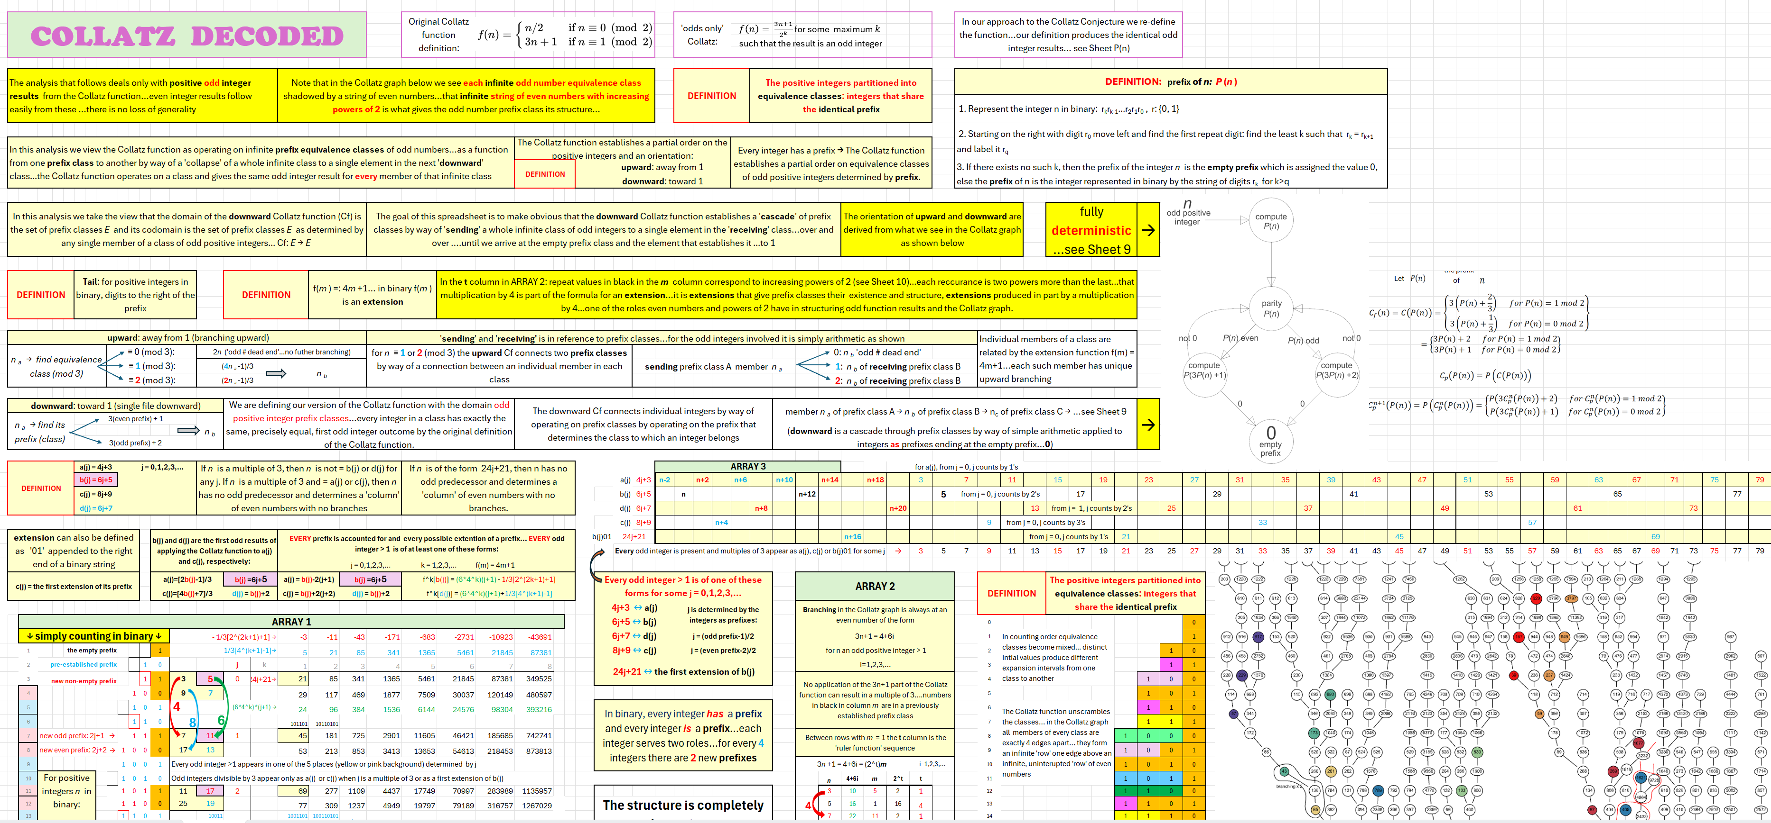
https://21stcenturyparadox.com/2025/12/06/collatz-decoded-7-12-25/

Slide 20
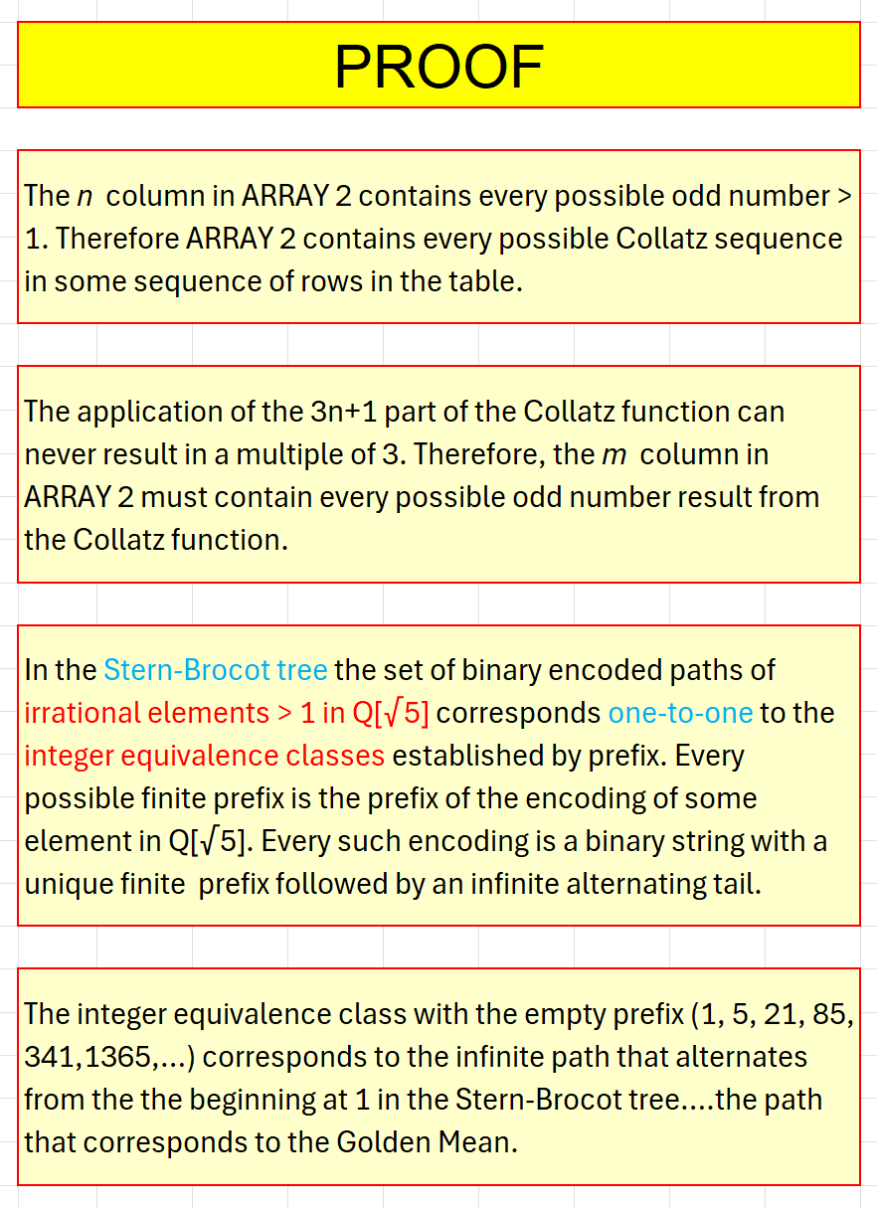
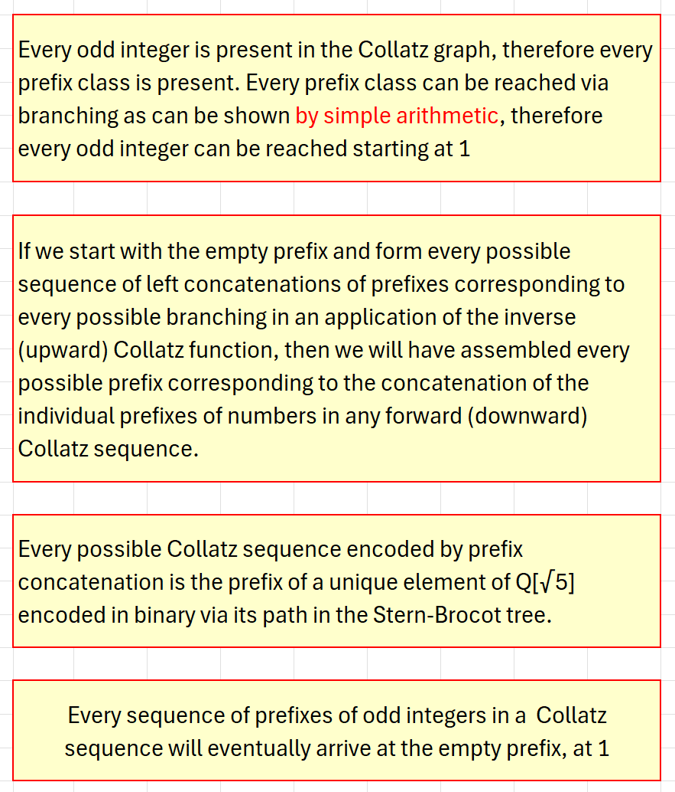
Notes:
A proof

Slide 21
Questions?
Comments?

